Slide 1

The Dendotrons
Kaggle: Allstate
Kawtar Belmkaddem
Jhonasttan Regalado
Jason Sippie
Nathan Stevens
Chris Valle
Conred Wang

Slide 2
Outline
Team Dynamics
EDA
Unsupervised ML
Supervised ML
Takeaways

Slide 3
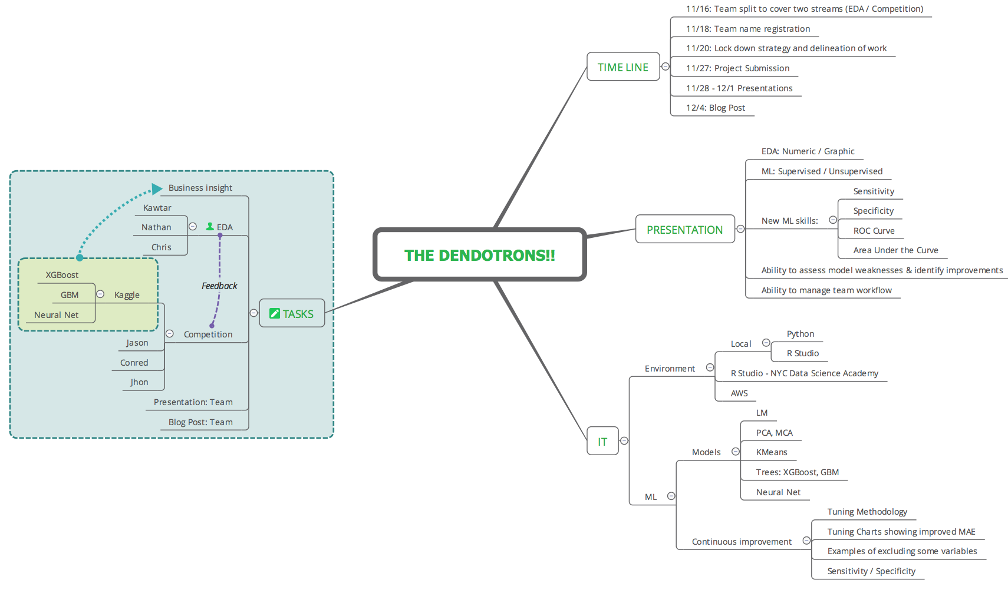
Team Development / Management

Slide 4
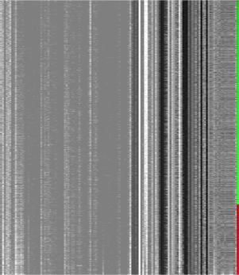
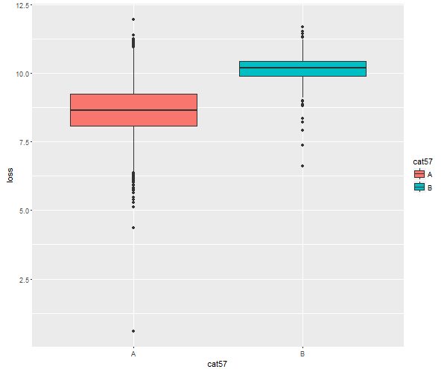
EDA
Gray scale image visualising the dataset with features ordered by the log loss. You can see patterns in which the values of particular features change as loss increases.
CAT57 versus Log Loss
Notes:
Add boxplot of cat72

Slide 5
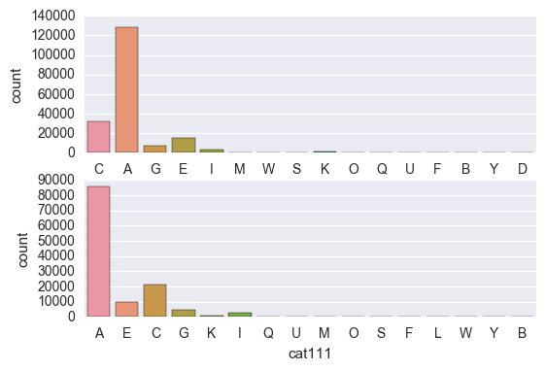
EDA - Comparison between test and train datasets
Some categorical variables are not present in the test set in total 45 variables
Train
Test

Slide 6
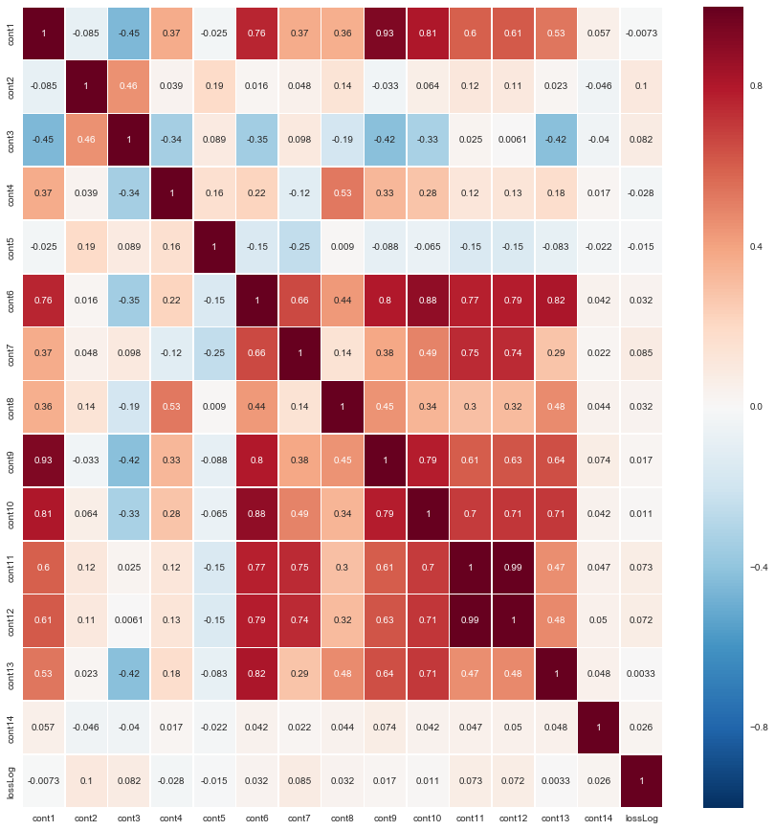
EDA - Correlation between continuous features
Continuous variables
Variables | Correlation
Cont 11 & Cont 12 | 0.994384
Cont 1 & Cont 9 | 0.929912
Cont 6 & Cont 10 | 0.883351
Cont 6 & Cont 13 | 0.815091
Cont 1 & Cont10 | 0.808551
Cont 9 & Cont 6 | 0.797544
Cont 9 & Cont 10 | 0.785697
Cont 6 & Cont12 | 0.785144

Slide 7
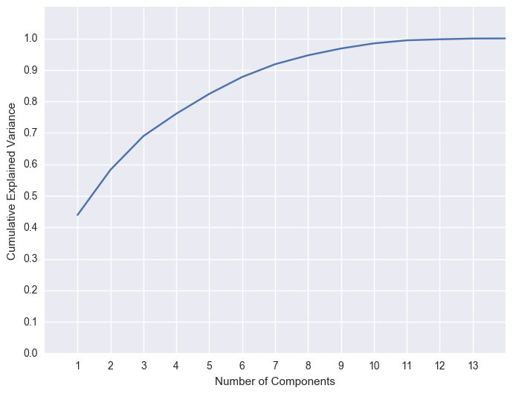
PCA- Dimensionality reduction
Dimensionality reduction for continuous variables using PCA : We have 14 continuous features
We can can reduce the number of continuous data to the half

Slide 8
EDA - Correlation between 2-variables categorical features
72, 2-variables categorical data (A,B)
Variables | Correlation
Cat 2 & Cat 9 | 0.932420
Cat 50 & Cat 6 | 0.925731
Cat 8 & Cat 66 | 0.862231
Cont 57 & Cont 7 | 0.809418
Cont 3 & Cont 16 | 0.783480
Label encoding
Numerical values
Correlation

Slide 9
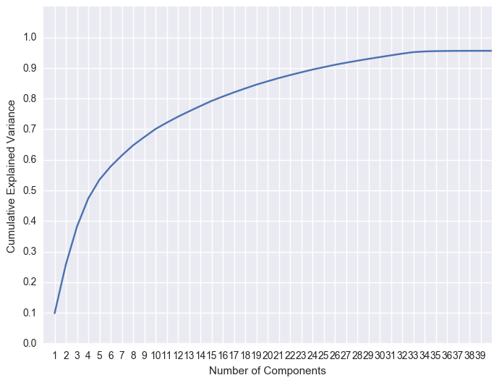
SVD - Correlation between 2-variables categorical features
SVD: Singular Value Decomposition
We can reduce the number of 2-variable categorical data to 26 variables

Slide 10
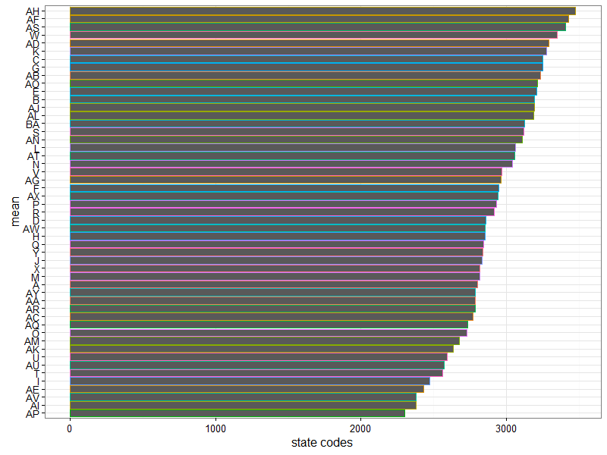
State Mean Loss
Assuming cat112 == US states
Average loss per state
Calibrate premium setting for states with very high loss rate

Slide 11
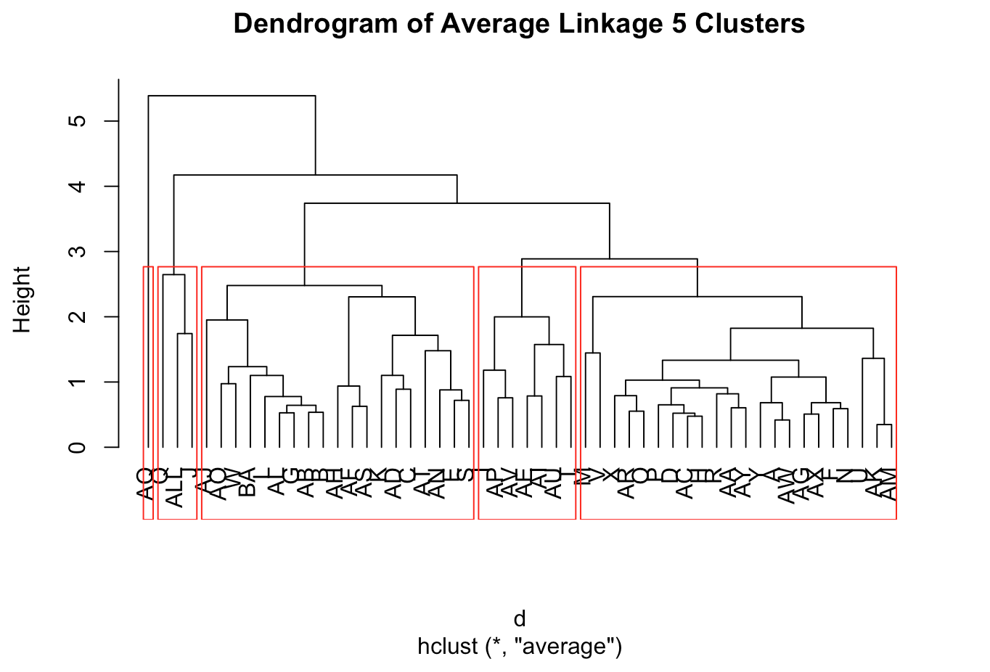
Hierarchical Clustering into Five Groups

Slide 12
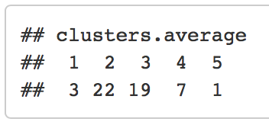
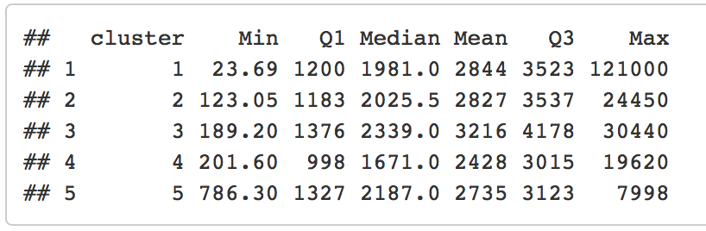
Hierarchical Clustering Cont...
We can consider performing feature engineering
We can consider removing AQ - only has 30 observations

Slide 13
Machine Learning for Prediction
Tactics to Reduce Iteration Time:
Regularization
Near-zero variance function
Use p values from regression
Reduced # levels (e.g., cat116)
Sampling
Random sampling
Sampling cat80D versus B
Other
Used AWS, but parallel processing not always a turn-key solution
Reduce # folds in validation
Models Examined:
Regression
Linear regression -- R^2 of 50%. Good for initial analysis
Boosted trees -- XGBoost had best performance
Neural network -- close second to XGBoost
XGBBoost + NN => marginal improvement MAE 1126
Classification
Logistic regression
SVM

Slide 14
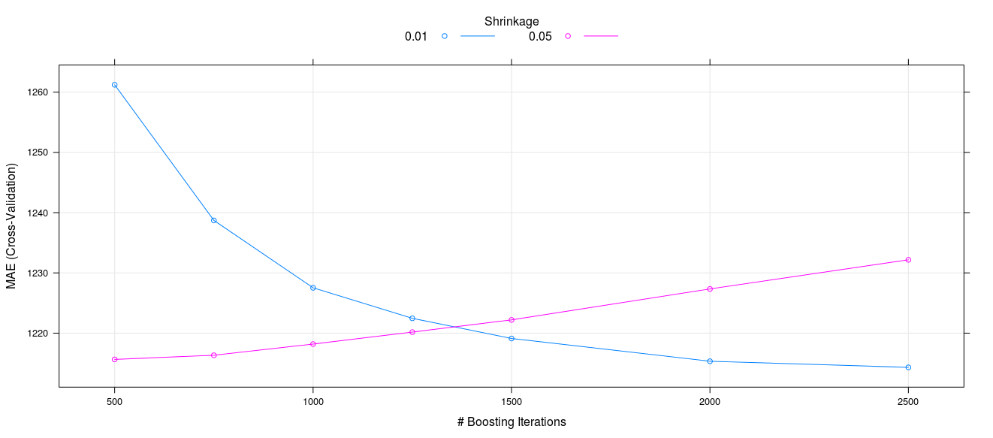
Machine Learning for Prediction -- XGB Model Tuning
Final result: 850 iterations, learning rate 0.05, 5 trees
Prediction unstable with reduced cross-validation folds
Regularization penalized MAE $300

Slide 15
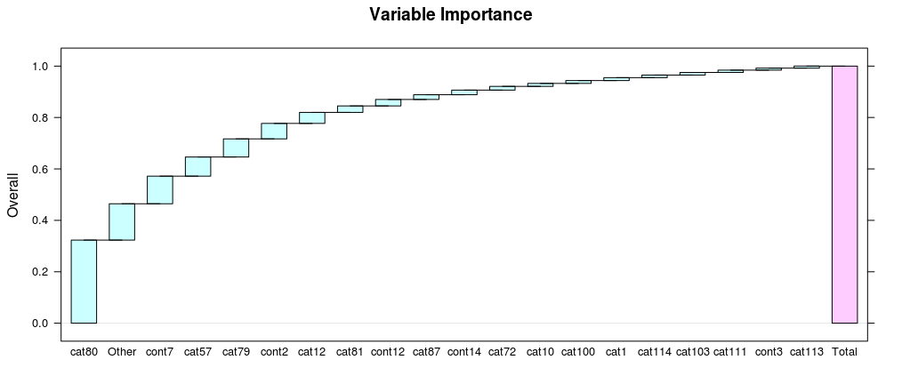
Machine Learning for Prediction -- Model Assessment
Cat80 largest single predictor

Slide 16
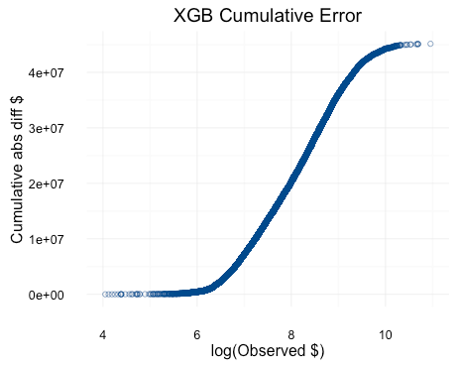
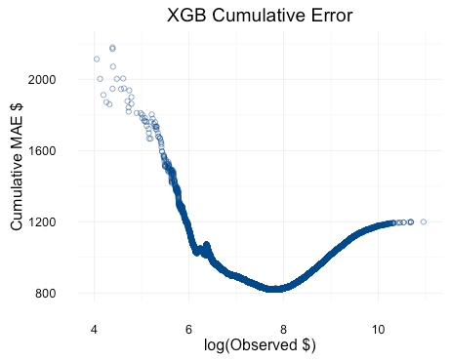
Machine Learning for Prediction -- XGB Model Tuning
Most of error for claims between exp($6) and exp($9) ~($400-$8000), therefore no need to get distracted by tails
Model gets more accurate until exp($8) ~$3000, then performance degrades

Slide 17
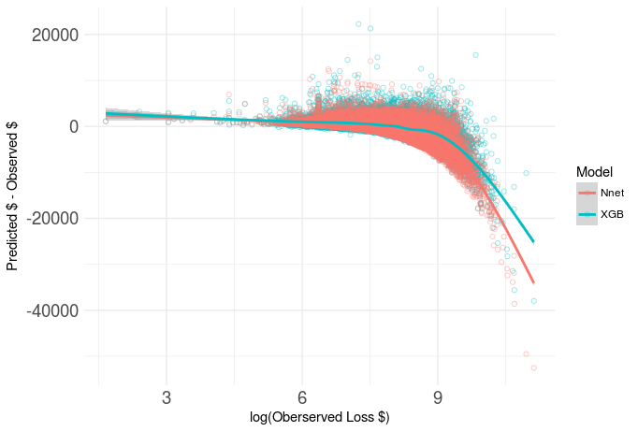
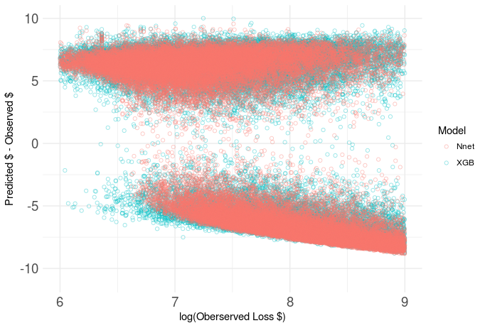
Machine Learning for Prediction -- Model Assessment
Minimal contribution to MAE
Underestimates increase with loss

Slide 18
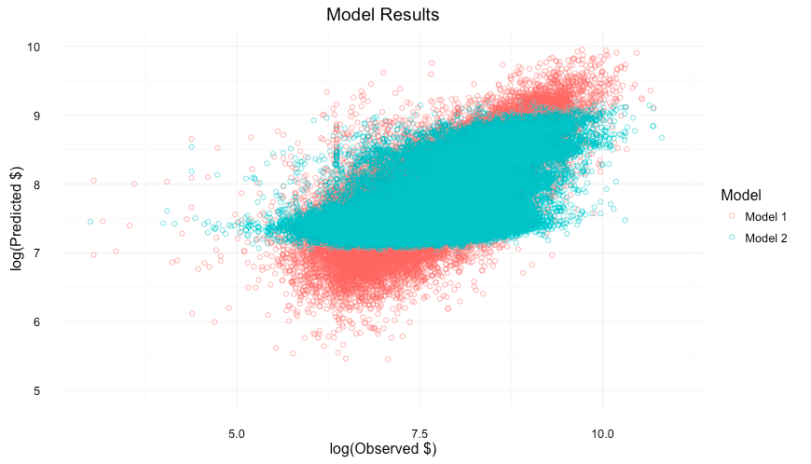
Linear Regression w/ 6 Features vs XGBoost with all Features

Slide 19
What’s Salvageable?
When you’ve been devastated by a serious car accident, your focus is on the things that matter the most: family, friends, and other loved ones. Pushing paper with your insurance agent is the last place you want your time or mental energy spent.
Conclusion: claim size can not be accurately predicted based on provided features
Root Problem
Doing paperwork for claim protects insurer against fraud
May be able to reduce paperwork burden for claims if they don’t look “fishy”
Can features support a classification question?
New classifier: “smallClaim”
80% of customers account for 50% of claims by value -- all below $4500
“Fishy” claims: feature set associated with small claim value, but requested value is large (the opposite is not important for protection against fraud)

Slide 20
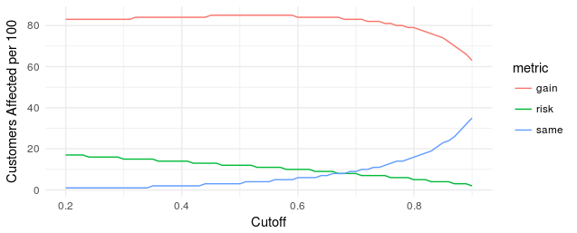
Fishing for Fishy Claims
Models used: GB, SVM, logistic regression. All had high accuracy but ~50% sensitivity.
We needed something that can be optimized to minimize false positives (logistic)
Next Steps: quantify dollar risk of misclassification and dollar benefit to customer of reduced paperwork

Slide 21
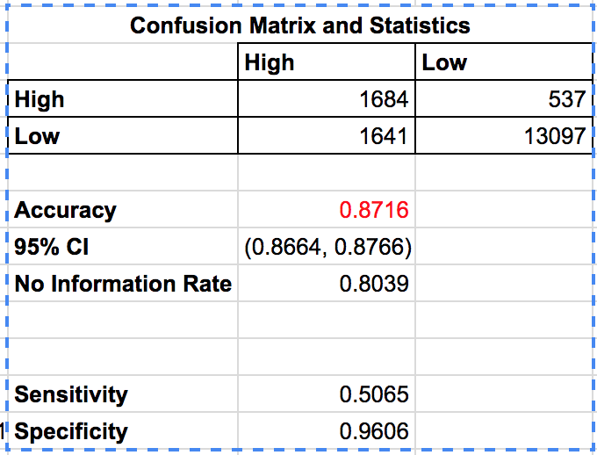
Classification Model: Low Profile with High Valued Accounts
Training a classification model (using GBM) with a profile having a loss value <= $4500 provides 87% accuracy.
Sensitivity (false positive) rate of 50% results in half the low profile accounts being falsely identified as high profile, hence increasing the paperwork process.
Specificity (false negatives) rate of 96% indicates a low error rate of 4%; thus a low probability of missing a low profile account with a high value claim request.

Slide 22
Conclusion
Kaggle Competition
To what degree are we improving performance versus overfitting the test data?
Continue to fine tune models to improve scoring (mean absolute estimate) in Kaggle
Business Insight
Tune classifier model by incorporating missing categorical values into the training / test set
Reducing CV folds is a mixed blessing: useful initially, but becomes easy to overfit

